Slide 1


Slide 2
Introduction to jquery
1

Slide 3
Topics
Motivation for jQuery
History Of jQuery
What is jQuery
jQuery vs Custom JavaScript
jQuery vs Other JavaScript Libraries
Quick Start jQuery

Slide 4
Motivation for jQuery
JavaScript has regained its prestige as rich internet applications and Ajax gaining popularity
Rapid Application development is made possible by the use of straightforward JavaScript , CSS and HTML.
Replace the cut-and-paste codes by full-featured JavaScript libraries and also to solve difficult cross-browser problems
Improved patterns for web development.
Lazy Initialization,Composite,Façade,Observer etc.,
jQuery-driven code is easier to write, simpler to read, and fasterto execute than its plain JavaScript equivalent.

Slide 5
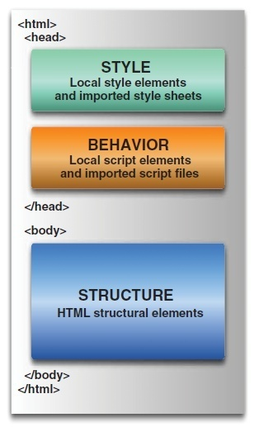
Unobtrusive JavaScript
Technique to have a clear separation of responsibilities
A web page with structure, style, and behavior each partitioned
Client-side code with the same level of care and respect as server-side code
Extra work—But Not with JQuery.

Slide 6
What is jQuery
jQuery is a JavaScript library that simplifies:
HTML element selection and document object model (DOM) traversal
Element creation, deletion, and modification
Event handling
Animation
Ajax interactions
Custom widget integration (date picker, slider, dialogs, tabs, etc…) with jQuery UI
jQuery is:
Free!
Open-source
lightweight footprint
Cross-browser compatible
Extensible! can write plugins or pick the one among a large list of existing ones.

Slide 7
History of jQuery
The First Stable version of jQuery v1.0 was released in 2006 by a team headed by John Resig
The Latest version of jquery 1.9 and 2.0 are announced
Can be downloaded from the http://jquery.com/download/
Minified Version :
compressed version with whitespaces and comments stripped out, shorter variable names in order to preserve bandwidth.
Can use normal jquery.js version for Debugging purpose

Slide 8
Adding JQuery
Local System
Can add using <script> by downloading the minified version
<script type="text/javascript" src="path/to/jquery.min.js">
Adding Jquery with Google CDN
http://ajax.googleapis.com/ajax/libs/jquery/1.7.1/jquery.min.js
http://ajax.googleapis.com/ajax/libs/jquery/1.7/jquery.min.js
To refer to the latest version of jQuery,
http://ajax.googleapis.com/ajax/libs/jquery/1/jquery.min.js

Slide 9
Adding jQuery with Google CDN
Google has jQuery libraries on its Content delivery network and allows any website to use it for free.
Caching: The most important benefit is caching. If any previously visited site by user is using jQuery from Google CDN then the cached version will be used. It will not be downloaded again.
Reduce Load: It reduces the load on web server as it downloads from Google server's.
Serves fast : As Google has dozen's of different servers around the web and it will download the jQuery from whichever server closer to the user.
Parellel Downloading: As the js file is on a separate domain, modern browsers will download the script in parallel with scripts on your domain.

Slide 10
The jQuery Function
$() function returns a JavaScript object containing an array of the DOM elements
Wraps the collected elements with extended functionality.
Return group of elements, which can be ready for another action.
To collect a group of elements, pass the selector to the jQuery function
$(selector)
Or
jQuery(selector)
$ is an alias for the jQuery() function

Slide 11
jQuery( callback )
Binds a function to be executed when the DOM has finished loading.
$(function() {
// Document is ready
});
Creating a failsafe jQuery code using the $ alias, without relying on the global alias.
jQuery(function( $ ) {
});

Slide 12
Document Ready Handler
The onload handler, executes statements after the entire page is fully loaded.
This delays execution until after the DOM tree is created and all external resources are fully loaded and the page is displayed in the browser window.
Can trigger the execution of code once the DOM tree has loaded and without waiting for external resources.
jQuery(document).ready(function() {
alert(jQuery('p').text());
});
$(function(){alert($ ('p').text());
});

Slide 13
First JQUERY-Anonymous Functions
<head>
<script type="text/javascript" src="js/jquery.js"></script>
<script type="text/javascript" >
$(document).ready(function() {
$("#msgId").html("<b>Hello From JQuery<b>");
});
</script>
</head>
<body>
<div id="msgId"></div>
</body>

Slide 14
JQuery with Named Functions
<script type="text/javascript" src="js/jquery.js"></script>
<script type="text/javascript" >
function setValue()
{
$("#msgId").html("Hello From JQuery")
}
$(function() {
$("#echoButton").click(setValue);
$("#echoButton").click(setValue());
});
</script>
<p id="msgId">Example</p>
<input type="button" value="Get TextFld Value" id="echoButton"/>

Slide 15
Selection
2

Slide 16
Topics
Basic Selectors
Hierarchy Selectors
Selection By Attribute
Form Selectors
Position Filters

Slide 17
Basic Selectors
Basic jQuery selectors work the same as CSS selectors:
$(“*”) - // Selectors return a pseudo-array of jQuery elements
Selectors start with $(), representing the global jQuery function
It can take following arguments
Tag Name: Represents a tag name available in the DOM.
Tag ID: Represents a tag available with the given ID in the DOM.
Tag Class : Represents a tag available with the given class in the DOM.
If more than one element has the same id only the first matched element in the DOM will be returned

Slide 18
Basic Selectors
<p id="id1">Java</p>
<p id="id2" class="style1">JEE</p>
<div>Spring</div>
=$("#id1").text();
$(".style1").text();
=$(“div“).text();

Slide 19
Controlling the context
$(“”, $()) -> function can have a second argument
First argument -> is a selector,
Second argument -> denotes the context of the operation.
To Select the list Item inside a Division Identified with “colLef”
$("li", $(“#colLef")).css("border", "2px solid red");
Context of Selection
Element to Selection

Slide 20
Selection By Attribute
$('a[href]');
Selects all <a> elements that have an href attribute.
$('a[href=“Welcome.html"]');
Selects all <a> elements whose href attribute exactly matches Welcome.html.
$(“div[id^=‘main’]”)
Select all div elements Id starting with main
$(“div[id$=‘name’]”)
Select all div elements Id END with name
$(“a[href*=‘msdn’]”)
Select all href elements containing msdn

Slide 21
Working with Attributes
Can manipulate an element's attributes
Set Attribute Value:
The attr(name, value)
set the named attribute onto all elements in the wrapped set using the passed value.
$("#myimg").attr("src", "/images/jquery.jpg");
removeAttr()

Slide 22
Hierarchy Selectors
$('#footer span');
Selects the <span> elements that are descendants of the element with the id footer.
$('ul > li');
Selects the <li> elements that are immediate children of <ul> elements.
$('h2 + p');
Selects the <p> elements that are immediately preceded by an <h2> element.
$('h2 ~ p');
Selects all <p> elements following an <h2> element that have the same parent as the <h2>element.

Slide 23
Form Selectors
:input -> Input, textarea, select, and button elements
:enabled -> Form elements that are enabled
:disabled -> Form elements that are disabled
:checked -> Radio buttons or checkboxes that are checked
:selected -> Option elements that are selected
$(":checkbox")implies $("*:checkbox")).
var retVal =$("input:text#txtFld1").val();
var retVal=$("input:radio[name=rad]:checked").val();

Slide 24
Find Dropdown Selected Item
<select name=“cities”>
<option value=“1”>Chennai</option>
<option value=“2”>Trichy</option>
<option value=“3”>Madurai</option>
</select>
$(“select[name=‘cities’] option:selected”).val()

Slide 25
Selecting by Position
a:first
This format of selector matches the first <a> element on the page.
p:odd
This selector matches every odd paragraph element.
p:even
This selector matches every even paragraph element.
ul li:last-child
chooses the last child of parent elements. In this example, the last <li> child of each <ul> element is matched
$('li:nth-child(2)')
selects all <li> elements that are the second child of their parent
$('li:nth-child(2n+1)')
(2 x 0) + 1 = 1 = 1st Element (2 x 1) + 1 = 3 = 3rd Element (2 x 2) + 1 = 5 = 5th Element

Slide 26
Selecting by Position
Can filter the elements selected based on their position in the collection
$('.article:gt(1)');
selects elements with an index number higher than a specified number.
List all elements with class article that are greater than index 1
$('.article:lt(3)');
From the collection of all elements with the class article, select up to the first three.

Slide 27
Other Selections
$(p:contains(‘java'));
Selects all <p> elements that contain the string “java", either directly or in any of the child elements.
The text matching is case sensitive.
$('div:has(h2)');
Selects all <div> elements that have at least one <h2> element as a descendant.
$('option:not(:selected)');
Selects all <option> elements that are not selected.
$('p:hidden'); , $('p:visible');
Selects all <p> elements that are hidden/visible.
An element is considered hidden if:
It has a CSS display value of none
It is a form element with type="hidden"
Its width and height are explicitly set to 0
An ancestor element is hidden, so the element is not shown on the page

Slide 28
jQuery Method Chaining
Selections return an instance of a jQuery object.
Returned instance can then invoke methods on the objects to manipulate the HTML elements it represents.
$('.status') .css('backgroundColor','yellow') .attr('title', 'Training by Ramesh');
This selects the elements with the class status, sets the background color of the selected elements to yellow, and then sets the title attribute of the selected elements.
Chaining works with events also
$('#dvContent').addClass('dummy') .css('color', 'red') .fadeIn('slow'); });​

Slide 29
CSS Styling and jQuery
4

Slide 30
Jquery Css
JQuery CSS selectors can be used to change CSS properties
CSS Methods do not modify the content of the jQuery object and they are used to apply CSS properties on DOM elements.
The method for CSS manipulation is css()
selector.css( PropertyName, PropertyValue );
$("li").css("color", "red")

Slide 31
Css Manipulations
To Get the Current Css Style associated with an Element
$(“div”).css(“background-color”);
From jQuery 1.9 : Can have multi-property getter.
var propCollection =
$("#dvBox").css([ "width", "height", "backgroundColor" ]);
propCollection will be an array of values.
{ width: "100px", height: "200px", backgroundColor: "#FF00FF" }

Slide 32
Set CSS Properties
To Set a New style to an Element
$(“div”).css(“float”, “left”);
To Set Multiple style properties
$(“div”).css({ “color”:”blue”, “padding”: “1em” “margin-right”: “0”, “marginLeft”: “10px” } );

Slide 33
Event handling

Slide 34
Event Handling
The event handling methods are core functions in jQuery.
Event handlers are method that are called when "something happens" in HTML.
The term "triggered (or "fired") by an event" is often used.
$(document).ready(function(){ $("button").click(function(){ $("p").hide(); }); });
<p>This is a paragraph.</p>
<button>Click me</button>

Slide 35
JQuery Events
$(document).ready(function)
Binds a function to the ready event of a document
$(selector).click(function)
Triggers, or binds a function to the click event of selected elements
$(selector).focus(function)
Triggers, or binds a function to the focus event of selected elements
$(selector).mouseover(function)
Triggers, or binds a function to the mouseover event of selected elements

Slide 36
Animation and effects

Slide 37
Showing and hiding elements
Showing or hiding elements are simple and pop elements into existence or make them instantly vanish!
show()
to show the elements in a wrapped set, and hide() to hide them.
jQuery hides elements by changing their style.display properties to none.
If an element in the wrapped set is already hidden, it will remain hidden but still be returned for chaining.

Slide 38
Useful Functions
.hide()
.show()
$(“div”).show();
$(“div”).show(“slow”);
$(“div”).hide(“fast”);
.toggle(func1, func2)
first click calls func1, next click executes func2
.hover(over, out)
mouseover, mouseout

Slide 39
Hover Method
<script>
$(document).ready(function(){
$("p").hover(function(){
$("p").css("background-color","yellow");
},function(){
$("p").css("background-color","pink");
});
});
</script>
</head>
<body>
<p>Hover the mouse pointer over this paragraph.</p>
</body>

Slide 40
Jquery –ajax interaction

Slide 41
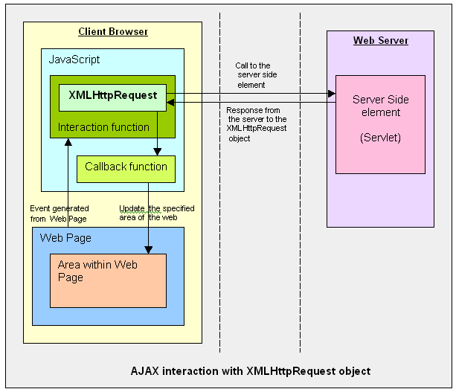
Ajax Interaction
Notes:
So how does AJAX application performs the asynchronous
communication with the server?
This slide also compares conventional web application and AJAX
application. In the left side, which shows the conventional web
application, HTTP request/response interaction occurs directly
between a browser and a backend web application.
In the right side, which shows AJAX based web application, within
a browser, there is AJAX engine, which is actually represented by a
JavaScript object called XMLHttpRequest which handles the HTTP
request/response interaction in an asynchronous fashion.

Slide 42
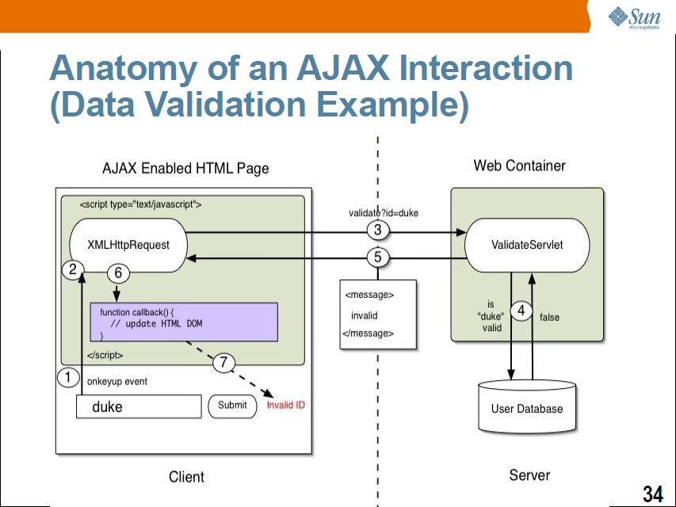
Ajax Interaction

Slide 43
XMLHttpRequest
JavaScript object
Adopted by modern browsers
Mozilla™, Firefox, Safari, and Opera
Communicates with a server via standard HTTP GET/POST
XMLHttpRequest object works in the background for performing asynchronous communication with the backend server
Does not interrupt user operation
Notes:
Now let's talk about XMLHttpRequest a bit. It is a JavaScript object,
which means it gets created within a JavaScript code.
The XMLHttpRequest JavaScript object is supported in most modern
browsers.
It is the AJAX engine that performs the HTTP request/response
interaction with the backend web application in asynchronous
fashion.

Slide 44
Server-Side AJAX Request Processing
Server programming model remains the same
It receives standard HTTP GETs/POSTs
Can use Servlet, JSP, JSF, ...
With minor constraints
More frequent and finer-grained requests from client
Response content type can be
text/xml
text/plain
text/json
text/javascript
Notes:
Now, how does server side web application handle the AJAX
interaction with the browser? Well as far as Server side code is
concerned, it is just another HTTP request that comes in. The server
side does not even know the browser is sending the HTTP request
in asynchronous fashion and it should not.
What this means is that the server side web application can use any
server side technology of its choice such as servlet, JSP, JSF,
Struts, or whatever.
The server side application however has minor constraints. First, it is
possible the client might send more frequent and finer grained
requests. The response type can be text/xml, text/plain, text/json, or
text/javascript.

Slide 45
Steps of AJAX Operation
A client event occurs
An XMLHttpRequest object is created
The XMLHttpRequest object is configured
The XMLHttpRequest object makes an async. request
The Servlet/JSP returns an XML document containing the result
The XMLHttpRequest object calls the callback() function and processes the result
The HTML DOM is updated

Slide 46
Jquery Ajax
jQuery.ajax() method. – Used to make Ajax Calls
It has common options of a request type, url, dataType,error, and success:
The first option that needs to be addressed when starting an Ajax request is the type of HTTP request
var options = {
type: 'GET',
url: 'hello-ajax.jsp',
dataType: 'html'
};
$.ajax( options );

Slide 47
JQuery Ajax
var options = {
type: 'GET',
url: 'hello-ajax.html',
dataType: 'html',
error: function(xhr, textStatus, errorThrown) {
alert('An error occurred! ' + errorThrown);
},
success: function(data, textStatus) {
$('body').append( data );
}
};
$.ajax( options );

Slide 48
Making an Ajax Call
$(document).ready(function(){
$("button").click(function(){
$.ajax({url:"First.Jsp", success:function(result){
$("div").html(result);
}});
});});
</script>
</head>
<body>
<div><h2>Let AJAX change this text</h2></div>
<button>Change Content</button>
</body>
</html>

Slide 49
JQuery AJAX Events:
The methods used during the life cycle of AJAX call progress.
Based on different events/stages following methods are available:
ajaxComplete( callback ) Attach a function to be executed whenever an AJAX request completes.
ajaxStart( callback )
Attach a function to be executed whenever an AJAX request begins and there is none already active
.ajaxError( callback )
Attach a function to be executed whenever an AJAX request fails.
ajaxSend( callback )
Attach a function to be executed before an AJAX request is sent.
ajaxStop( callback )
Attach a function to be executed whenever all AJAX requests have ended
ajaxSuccess( callback )
Attach a function to be executed whenever an AJAX request completes successfully.

Slide 50
Ajax Events
Within the ready handler on the page, we also establish a number of event handlers as follows:
$('body').bind(
'ajaxStart ajaxStop ajaxSend ajaxSuccess ajaxError ajaxComplete',
function(event){ say(event.type); }
);

Slide 51
JQuery AJAX Methods:
jQuery.ajaxSetup( options ) :
Load a remote page using an HTTP request. Setup global settings for AJAX requests.
jQuery.get( url, [data], [callback], [type] )
Load a remote page using an HTTP GET request.
jQuery.getJSON( url, [data], [callback] ):
Load JSON data using an HTTP GET request.
jQuery.getScript( url, [callback] )
Loads and executes a JavaScript file using an HTTP GET request
.jQuery.post( url, [data], [callback], [type] )
Load a remote page using an HTTP POST request.
load( url, [data], [callback] ) Load HTML from a remote file and inject it into the DOM

Slide 52
JSON: JavaScript Object Notation.
Lightweight text-data interchange format
"self-describing" and easy to understand
Uses JavaScript syntax for describing data objects
JSON parsers and JSON libraries exists for many different programming languages
JavaScript program can use the eval() to get native JS objects.
{ "employees": [ { "firstName":"John" , "lastName":"Doe" }, { "firstName":"Anna" , "lastName":"Smith" }, { "firstName":"Peter" , "lastName":"Jones" } ] } The employees object is an array of 3 employee records (objects).

Slide 53
JSON Syntax Rules
JSON syntax is a subset of the JavaScript object notation syntax:
Data is in name/value pairs
Data is separated by commas
Curly braces hold objects
Square brackets hold arrays
JSON Name/Value Pairs
JSON data is written as name/value pairs.
A name/value pair consists of a field name (in double quotes), followed by a colon, followed by a value:
"firstName" : "John“ equivalent to firstName = "John"

Slide 54
Working With Json Data
Servers return JSON string against a request.
getJSON() parses the returned JSON string and makes the resulting string available to the callback function
[selector].getJSON( URL, [data], [callback] );
data:
An object whose properties serve as the name/value pairs used to construct a query string to be appended to the URL, or a preformatted and encoded query string.
Callback:
The data value resulting from digesting the response body as a JSON string is passed as the first parameter to this callback, and the status as the second.

Slide 55
Generating JSON Data
User user = new User(101,”Ramesh);
ObjectMapper mapper = new ObjectMapper();
try {
mapper.writeValue(new File(“user.json"), user);
System.out.println(mapper.writeValueAsString(user));
} catch (Exception e) {
e.printStackTrace();
}

Slide 56
Working With Json Data
$(document).ready(function() {
$("#driver").click(function(event){ $.getJSON('user.json', function(jd) {
$('#id1').html('<p> Name: ' + jd.name + '</p>');
$('#id1').append('<p>Age : ' + jd.age+ '</p>');
});
});
});
<div id="id1" > </div>
<input type="button" id="driver" value="Load Data" />

